Slide 1
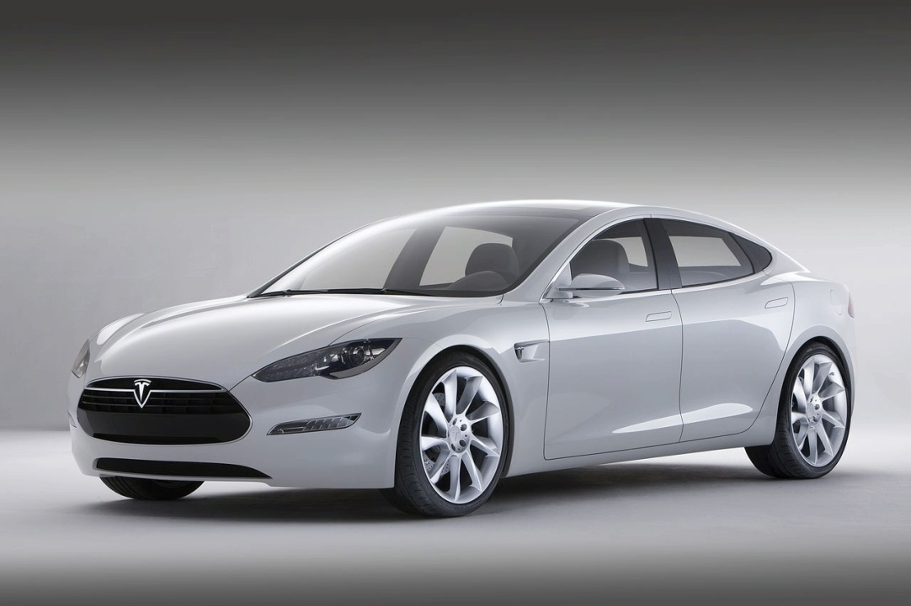
Tesla Motors
An Analysis of Tesla’s Marketing Efforts in the U.S.
Adam Cimala
Evangeline Demos
Pandi Lera
Andre Jordan Sanchez

Slide 2
Tesla Motors
U.S Automotive Market Characteristics
U.S. Automotive Market is largest in the world
11.5 million vehicles purchased in 2009 alone
8 million vehicles produced every year in U.S.
Also the most competitive, large number of firms

Slide 3
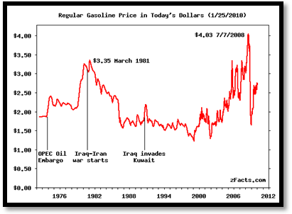
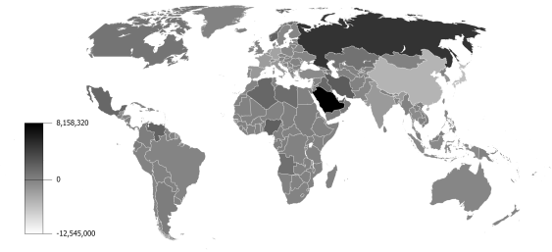
Tesla Motors
U.S Automotive Market Characteristics
Automotive industry has faced external/internal pressures
Spiking oil prices due to middle-eastern conflicts
Gas Prices, 1976 - 2010
Source: U.S. Department of Energy
Gas Prices sensitive to any U.S. foreign policy changes
Who ends up paying? You do!
Oil Exporting Countries
Source: CIA World Fact book
Saudi Arabia, Venezuela, Nigeria, Iran, Russia

Slide 4
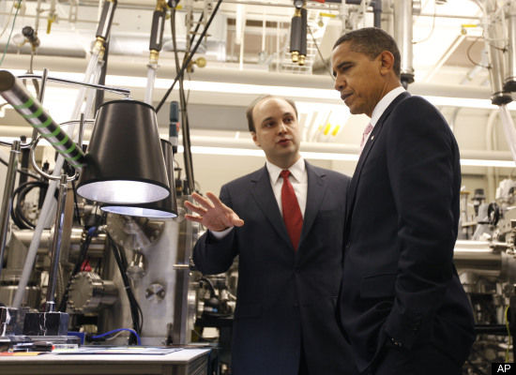
Tesla Motors
U.S Automotive Market Characteristics
Increased Environmental Awareness by Consumers
Popular Culture
Products
Building Certifications
The “Obama” Factor

Slide 5
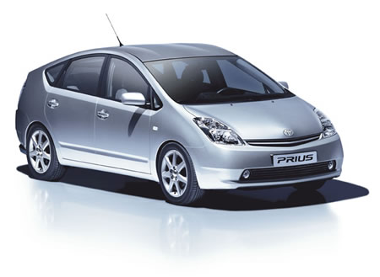
Tesla Motors
U.S Automotive Market Characteristics
Consumers values were changing starting in 2001!
SUV sales sank, consumers wanted fuel efficient vehicles.
Toyota capitalized on this first in the automotive industry…sort of.
Prius was a success for Toyota
As of 2009, 800,000 Prius on U.S. Roads
However, the Prius only targets a small % of the automotive market…

Slide 6
Tesla Motors
U.S Automotive Market Characteristics
Vehicle Type¹ | Examples | Price¹ | Target Market³ | % Change in Marketshare²
Compact | Smart Car Honda Fit/Civic Ford Focus Hyundai Toyota/Scion | <$20,000 | Younger Lower Income Single Urban | +16.2
Mid Sized | Honda Accord Honda Insight Nissan Altima Ford Taurus Ford Fusion | <$25,000 | Younger-Middle Aged Married Suburban College Graduates | +27.1
SUV/Utility | Ford F150 Chevy Hummer Lexus GMC | $20,000-$60,000 | Married/children Middle Aged Suburban Female Medium Income | +5.6%
Luxury | Cadillac Lexus Mercedes-Benz Acura BMW | >$40,000 | Wealthy Married Middle Aged College Graduates | +3.7%
Exotic | Ferrari Aston Martin Bentley Tesla | >$90,000 | Very Wealthy Married Male | N/A
^{Sources:}
¹ – As defined by the automotive industry. Source: US News & World Report 2010
² – Percent Change in sales from 2009 as of April 1, 2010. Source: Wall Street
³ - Demographic Data of Buyers. Source: Google Answers

Slide 7
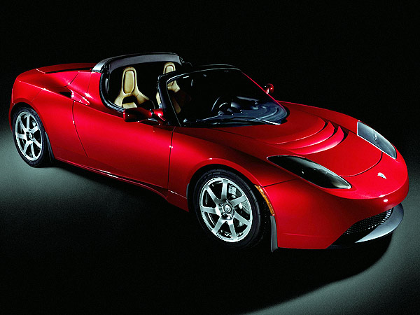
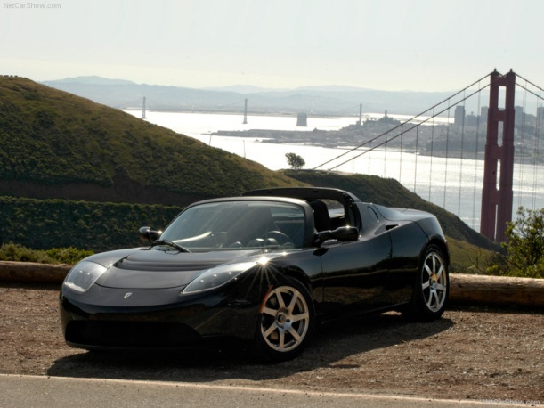
Tesla Motors
Product Profile
Tesla decided it would produce an electric car and target luxury and exotic sport car market
Tesla Roadster
Introduced in 2008
0 – 60 in 3.9 seconds
$100,000 - (Federal Tax Rebate)
200 miles on one charge
0 emissions
Target market – The Environmentally friendly CEO
Reviews
“You don’t have to go slow to go green”
“The Tesla is $130,000 of Electric Sex”

Slide 8
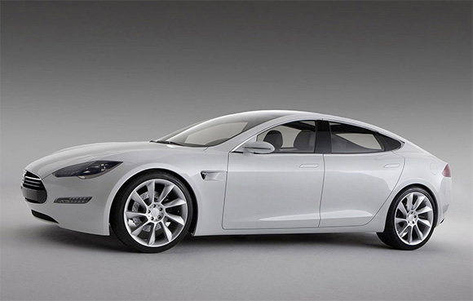
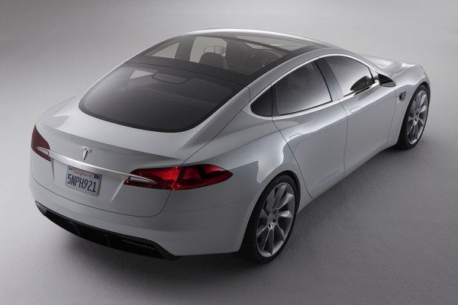
Tesla Motors
Product Profile
Tesla Motors Model S
Family sedan with sporty silhouette
Equipped with high end technology
Seating for 5 adults + 2 child seats
Unique hatch for oversized items
60/40 flat folding rear seat
Second trunk under hood
Performance
Dynamics of a sport car
Accelerates 0-60 mph in 5.6 seconds
120 mph top speed
300 mile range
45 minute “Quick Charge”
Benefits
Economic $5 cost per 300 miles
Environmentally friendly – 0 emissions

Slide 9
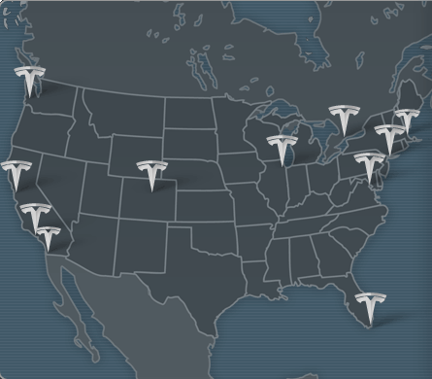
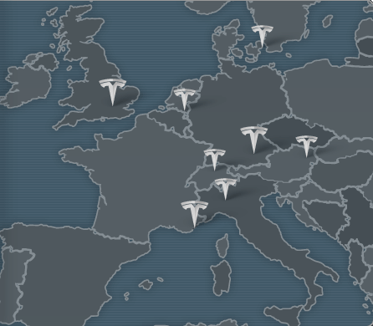
Tesla Motors
Tesla Worldwide Store Locations
Product Profile
Target market
11 stores in North America
19 stores worldwide
United Kingdom
Germany
Austria
Switzerland
Norway
Benelux
Monaco
Italy
Targeted to
Current owners of Roadster model
Wealthy families
Executives
Source: Tesla.com

Slide 10
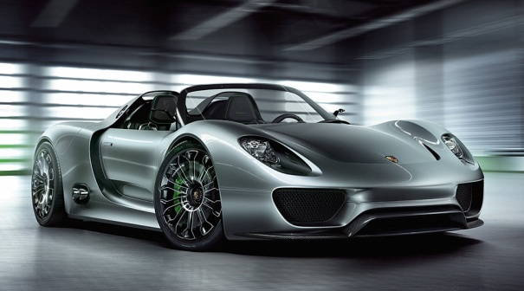
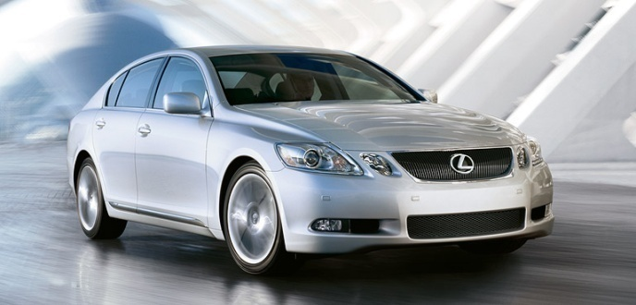
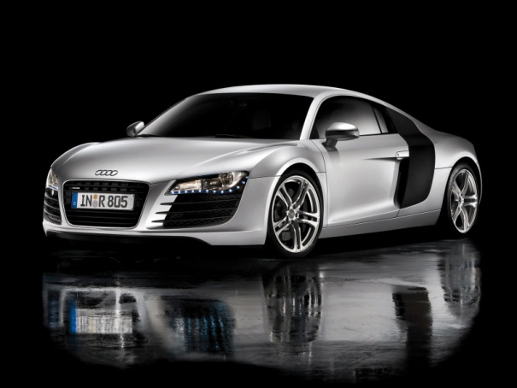
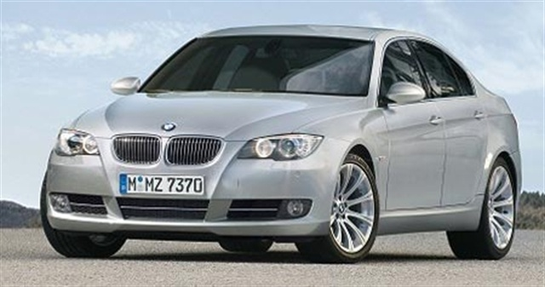
Tesla Motors
U.S Automotive Market Characteristics
Tesla Motors faces heavy competition from gasoline & hybrid vehicles
Tesla Roadster
Tesla Model S

Slide 11
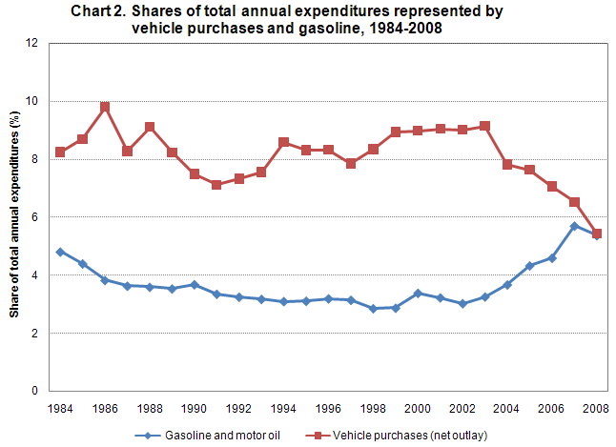
Tesla Motors
U.S Automotive Market Characteristics
S.W.O.T. Analysis
Strengths | Weakness | Opportunity | Threats
*High Demand for Tesla Products *Niche Market where it is only firm *Good PR *Excellent vehicle design *Only all Electric commercial luxury/sports car | *Tech still needs development *Low Brand Awareness *Uncertain Resale Value *Low amount of Tesla service departments *Few consumers distinguish between a hybrid and electric | *Dominate a niche market *Build enough brand loyalty to lock competitors out *Use momentum to leverage into more markets | *Competing firms have lots of capital to develop tech *Other Automakers have better brand awareness *BMW, Acura, Mercedes, Porsche, Lexus *Decreased consumer spending
Source: US Department of Labor & Statistics

Slide 12
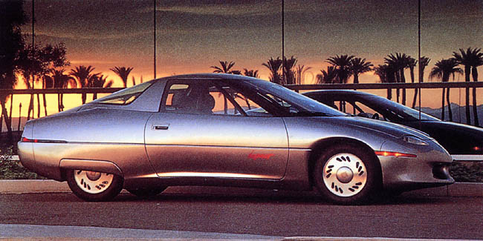
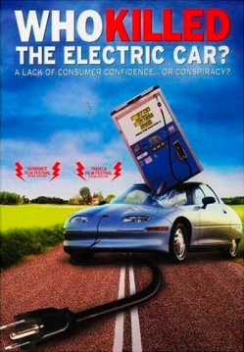
Tesla Motors
U.S Automotive Market Characteristics
Technology considerations
Failure of EV1
40 miles on charge
Has Tesla overcome these technology hurdles?
Patented technology
Who Killed the Electric Car Trailer
http://www.youtube.com/watch?v=nsJAlrYjGz8

Slide 13
Tesla Motors
U.S Automotive Market Characteristics
“Society shapes the beliefs, values, and norms that largely define consumer preferences”
Views of Society - Consumption patterns often reflect social attitude.
Views of nature - People have awakened to nature’s fragility and finite resources
Core values - protecting the environment or limiting dependence on foreign oil.
Subcultures: Environmentalists, “tree-huggers”, green parties
Class: Upper to upper-middle class
Natural Environment: “green parties” have pressed for public action to reduce industrial pollution.

Slide 14
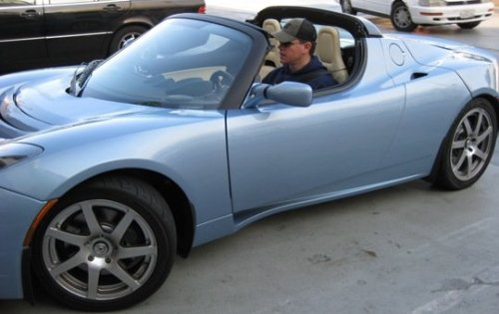
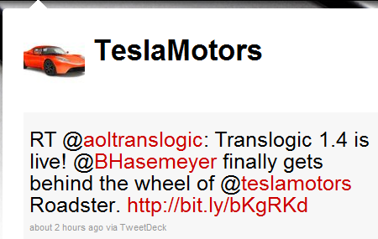
Tesla Motors
U.S Automotive Market Characteristics
Social Environment
Tesla targets subcultures
Celebrity endorsements
Web 2.0 methods
Twitter,
Facebook
Blogging

Slide 15
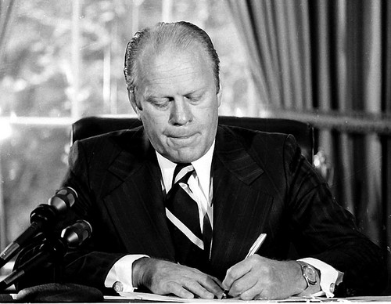
Tesla Motors
U.S Automotive Market Characteristics
Legal Environment
Tesla v. Fisker
Tesla’s CEO Elon Musk was sued by the company’s co-founder Martin Eberhard for “libel”
Class Action Suit by former employees
Energy Policy Conservation Act of 1975
and CAFÉ Standards
Energy Independence and Security Act
Special Interest Groups:
Opponents - Big Oil Companies
Proponents - Environmentalists

Slide 16
Tesla Motors
U.S Automotive Market Characteristics
Problems
Cost
Limited Range
Limited Electric Charge Stations
Opportunities
Saves money on gas & maintenance costs
State-specific perks-drive in HOV lane without a passenger, free metered parking, grants toward the purchase price, tax exemptions, etc.
Federal Tax Incentives
Insurance savings

Slide 17
Tesla Motors
Product Strategy
Product Levels
Core → means of transportation
Basic → seats, radio, AC
Expected → safety, reliable
Augmented → electric power, 0 emissions
Potential → tax breaks, part of a “revolution”
Product Mix
Roadster and S type
Each mix has different product lines
Roadster sport and non-sport
S type has more depth
Up – Market stretch with S Signature

Slide 18
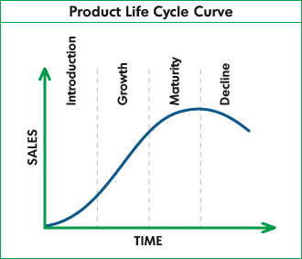
Tesla Motors
Product Strategy
Warranties
3 years/36000miles base warranty
Option to extend up to 4years/50000miles
Product Life Cycle (PLC)
Introduction Stage
Inform potential customers
Product trial
Secure retail distribution

Slide 19
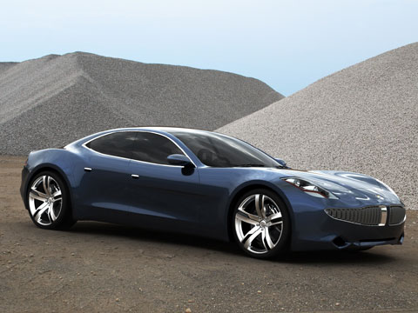
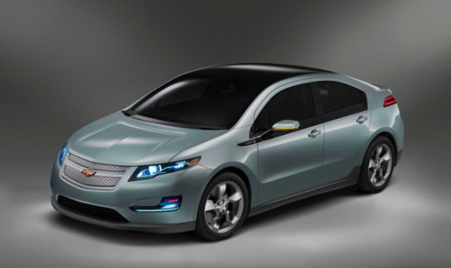
Tesla Motors
Pricing Strategy
Consumer Psychology
Reference prices
Fisker Karma → plug-in hybrid $87,900
Chevy Volt → estimated around $40,000
CEO’s perspective:
The ownership cost of Model S, if you were to lease and then account for the much lower cost of electricity versus gasoline at a likely future cost of $4 per gallon, is similar to a gasoline car with a sticker price of about $35,000," he wrote. Because they have fewer moving parts and don't require oil changes, electric vehicles should also have lower maintenance costs. "Model S costs roughly $5 to drive 230 miles--a bargain, even if gasoline were $1 per gallon

Slide 20
Tesla Motors
Pricing Strategy
Pricing objective → maximize market share
Demand curves should be based on Roadster
When selecting need to account for one of these areas:
Customers demand
Cost function
Competitor’s prices
Profit
Focus on cost function pricing strategy
In the long run cost of production will decrease and profits will increase
Price adaption strategies:
$7,500 tax reduction
As product moves through PLC consider new allowances
Differentiated pricing → Signature S

Slide 21
Tesla Motors
Promotion Strategy
Four Key Functional Areas
Advertising
Promotions
Events/Experiences
Public Relations

Slide 22
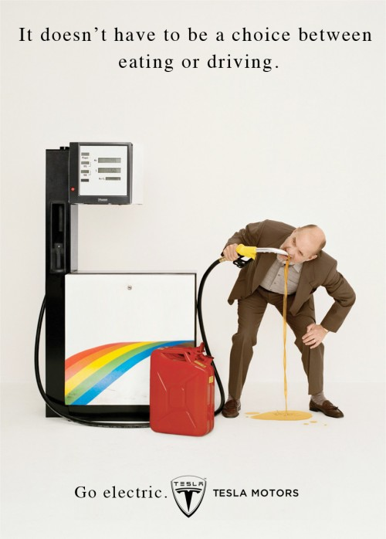
Tesla Motors
Promotion Strategy
Advertisement
Informative advertising
Create awareness
Advertising Campaign
Distinct message
Distribution through different media
Tesla should utilize
TV ads
Magazines
Internet Ads (besides Web 2.0)
Source: Cut-Copy Ad contest Winner

Slide 23
Tesla Motors
Promotion Strategy
Promotions
Advertisement offers a reason to buy, promotion offers an incentive to buy
$7,500 tax incentive
Should consider manufacturing rebates
Events/Experiences & PR
Being a new technology Tesla should offer hands on experience for new buyers to gain their support
PR
Mass advertisement is expensive, PR is a cheap alternative to increase awareness and brand knowledge

Slide 24
Tesla Motors
Tesla Worldwide Store Locations
Distribution Strategy
Distribution Strategy
Operations out of 19 stores in North America and Europe
Zero-level channel strategy
Positive:
Exceptional service
Down side:
Use of own resources → higher cost
Miss on marketing opportunities intermediaries provide
Source: Tesla.com

Slide 25
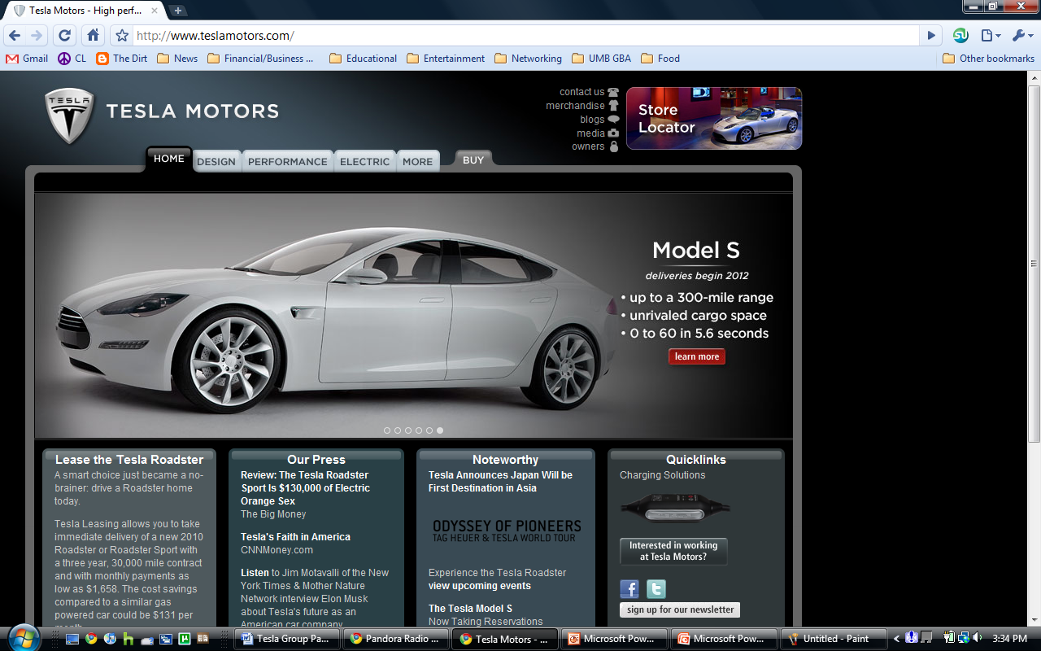
Tesla Motors
Distribution Strategy
Distribution Strategy
Pull strategy
Clients go through the Tesla website for any purchases
Future initiatives
Increase channel levels
One level with exclusive number of distributors

Slide 26
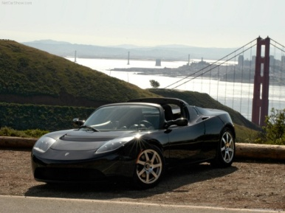
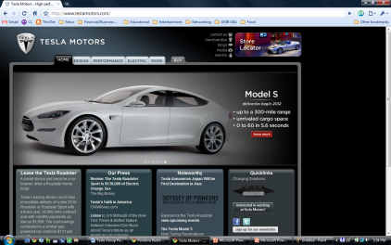
Tesla Motors
Recommendations
Other Recommendations
Define Electric vs. Hybrid Vehicles
Emphasize differences to consumer
Change Advertising Methods
Biggest Weakness = Brand Awareness
Tied to resale value
Warranty/Lease program?

Slide 27
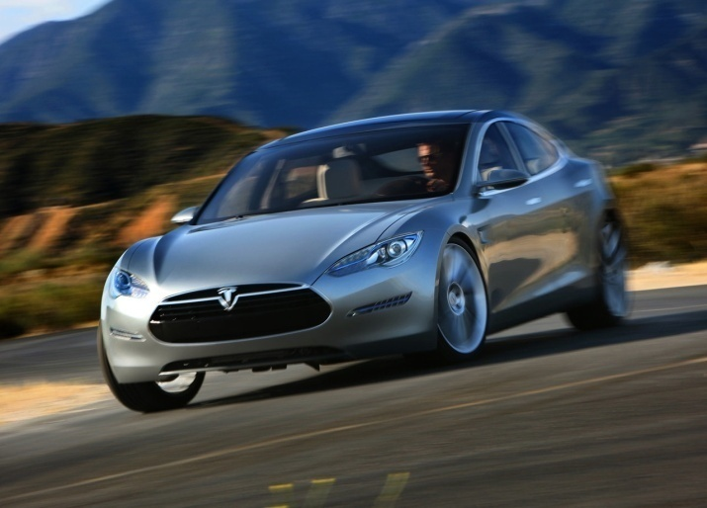
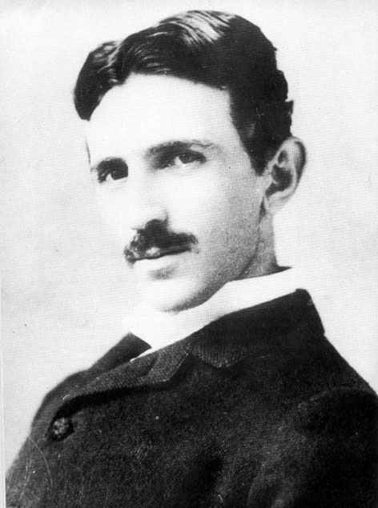
Tesla Motors
Questions?
Questions?
Questions?
Disclaimer: Tesla Motors is not to be confused with inventor Nikolai Tesla or the 80s glam-metal band, Tesla
Thank You!

